Slide 1
The Feasibility Study
What is a feasibility study?
  What to study and conclude?
Types of feasibility
  Technical
  Economic
  Schedule
  Operational
Quantifying benefits and costs
  Payback analysis
  Net Present Value Analysis
  Return on Investment Analysis
Comparing alternatives
Notes:
Batch - 01
Mohamed Ishraque
HND in CSD - SAD - Feasibilty Studies

Slide 2
Why a feasibility study?
Objectives:
  To find out if an system development project can be done:
    ...is it possible?
    ...is it justified?
  To suggest possible alternative solutions.
  To provide management with enough information to know:
    Whether the project can be done
    Whether the final product will benefit its intended users
    What the alternatives are (so that a selection can be made in subsequent phases)
    Whether there is a preferred alternative
A management-oriented activity:
  After a feasibility study, management makes a “go/no-go” decision.
  Need to examine the problem in the context of broader business strategy
Notes:
Batch - 01
Mohamed Ishraque
HND in CSD - SAD - Feasibilty Studies

Slide 3
Content of a feasibility study
Things to be studied in the feasibility study:
  The present organizational system
    Stakeholders, users, policies, functions, objectives,...
  Problems with the present system
    inconsistencies, inadequacies in functionality, performance,…
  Goals and other requirements for the new system
    Which problem(s) need to be solved?
    What would the stakeholders like to achieve?
  Constraints
    including nonfunctional requirements on the system (preliminary pass)
  Possible alternatives
    “Sticking with the current system” is always an alternative
    Different business processes for solving the problems
    Different levels/types of computerization for the solutions
  Advantages and disadvantages of the alternatives
Things to conclude:
  Feasibility of the project
  The preferred alternative.
Notes:
Batch - 01
Mohamed Ishraque
HND in CSD - SAD - Feasibilty Studies

Slide 4
Exploring Feasibility
The “PIECES” framework
  Useful for identifying operational problems to be solved, and their urgency
  Performance
    Is current throughput and response time adequate?
  Information
    Do end users and managers get timely, pertinent, accurate and usefully formatted information?
  Economy
    Are services provided by the current system cost-effective?
    Could there be a reduction in costs and/or an increase in benefits?
  Control
    Are there effective controls to protect against fraud and to guarantee information accuracy and security?
  Efficiency
    Does current system make good use of resources: people, time, flow of forms,…?
  Services
    Are current services reliable? Are they flexible and expandable?
See the course website for a more specific list of PIECES questions
Notes:
Batch - 01
Mohamed Ishraque
HND in CSD - SAD - Feasibilty Studies

Slide 5
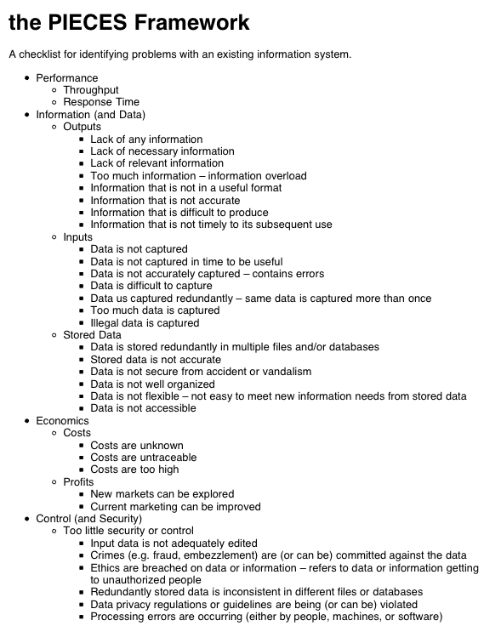
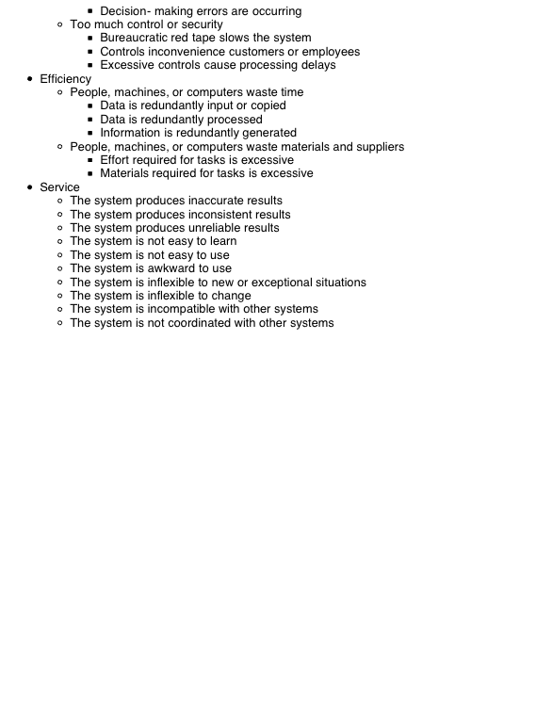
Notes:
Batch - 01
Mohamed Ishraque
HND in CSD - SAD - Feasibilty Studies

Slide 6
Four Types of feasibility
Technical feasibility
  Is the project possible with current technology?
  What technical risk is there?
  Availability of the technology:
    Is it available locally?
    Can it be obtained?
    Will it be compatible with other systems?
Economic feasibility
  Is the project possible, given resource constraints?
  What are the benefits?
    Both tangible and intangible
    Quantify them!
  What are the development and operational costs?
  Are the benefits worth the costs?
Schedule feasibility
  Is it possible to build a solution in time to be useful?
    What are the consequences of delay?
    Any constraints on the schedule?
    Can these constraints be met?
Operational feasibility
  If the system is developed, will it be used?
  Human and social issues…
    Potential labour objections?
    Manager resistance?
    Organizational conflicts and policies?
    Social acceptability?
    legal aspects and government regulations?
Technical feasibility
  Is the project possible with current technology?
Economic feasibility
  Is the project possible, given resource constraints?
Schedule feasibility
  Is it possible to build a solution in time to be useful?
Operational feasibility
  If the system is developed, will it be used?
Notes:
Batch - 01
Mohamed Ishraque
HND in CSD - SAD - Feasibilty Studies

Slide 7
Technical Feasibility
Is the proposed technology or solution practical?
  Do we currently possess the necessary technology?
  Do we possess the necessary technical expertise
    …and is the schedule reasonable for this team?
  Is relevant technology mature enough to be easily applied to our problem?
What kinds of technology will we need?
  Some organizations like to use state-of-the-art technology
    …but most prefer to use mature and proven technology.
  A mature technology has a larger customer base for obtaining advice concerning problems and improvements.
Is the required technology available “in house”?
  If the technology is available:
    …does it have the capacity to handle the solution?
  If the technology is not available:
    …can it be acquired?
Notes:
Batch - 01
Mohamed Ishraque
HND in CSD - SAD - Feasibilty Studies

Slide 8
Economic Feasibility
Can the bottom line be quantified yet?
  Very early in the project…
    a judgement of whether solving the problem is worthwhile.
  Once specific requirements and solutions have been identified…
    …the costs and benefits of each alternative can be calculated
Cost-benefit analysis
  Purpose - answer questions such as:
    Is the project justified (I.e. will benefits outweigh costs)?
    What is the minimal cost to attain a certain system?
    How soon will the benefits accrue?
    Which alternative offers the best return on investment?
  Examples of things to consider:
    Hardware/software selection
    Selection among alternative financing arrangements (rent/lease/purchase)
  Difficulties
    benefits and costs can both be intangible, hidden and/or hard to estimate
    ranking multi-criteria alternatives
Notes:
Batch - 01
Mohamed Ishraque
HND in CSD - SAD - Feasibilty Studies

Slide 9
Benefits Costs
Tangible Benefits
  Readily quantified as $ values
  Examples:
    increased sales
    cost/error reductions
    increased throughput/efficiency
    increased margin on sales
    more effective use of staff time
Intangible benefits
  Difficult to quantify
    But maybe more important!
    business analysts help estimate $ values
  Examples:
    increased flexibility of operation
    higher quality products/services
    better customer relations
    improved staff morale
How will the benefits accrue?
  When - over what timescale?
  Where in the organization?
Development costs (OTO)
  Development and purchasing costs:
    Cost of development team
    Consultant fees
    software used (buy or build)?
    hardware (what to buy, buy/lease)?
    facilities (site, communications, power,...)
  Installation and conversion costs:
    installing the system,
    training personnel,
    file conversion,....
Operational costs (on-going)
  System Maintenance:
    hardware (repairs, lease, supplies,...),
    software (licenses and contracts),
    facilities
  Personnel:
    For operation (data entry, backups,…)
    For support (user support, hardware and software maintenance, supplies,…)
    On-going training costs
Notes:
Batch - 01
Mohamed Ishraque
HND in CSD - SAD - Feasibilty Studies

Slide 10
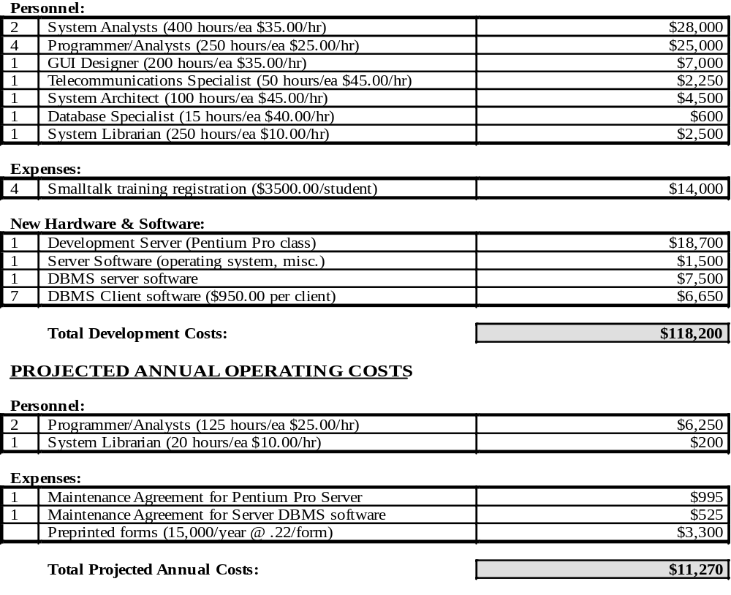
Example: costs for small Client-Server project
Notes:
Batch - 01
Mohamed Ishraque
HND in CSD - SAD - Feasibilty Studies

Slide 11
Analyzing Costs vs. Benefits
Identify costs and benefits
  Tangible and intangible, one-time and recurring
  Assign values to costs and benefits
Determine Cash Flow
  Project the costs and benefits over time, e.g. 3-5 years
  Calculate Net Present Value for all future costs/benefits
    determines future costs/benefits of the project in terms of today's dollar values
    A dollar earned today is worth more than a potential dollar earned next year
Do cost/benefit analysis
  Calculate Return on Investment:
    Allows comparison of lifetime profitability of alternative solutions.
    ROI = Total Profit = Lifetime benefits - Lifetime costs
    Total Cost Lifetime costs
  Calculate Break-Even point:
    how long will it take (in years) to pay back the accrued costs:
  @T (Accrued Benefit > Accrued Cost)
Notes:
Batch - 01
Mohamed Ishraque
HND in CSD - SAD - Feasibilty Studies

Slide 12
Calculating Present Value
A dollar today is worth more than a dollar tomorrow…
  Your analysis should be normalized to “current year” dollar values.
The discount rate
  measures opportunity cost:
    Money invested in this project means money not available for other things
    Benefits expected in future years are more prone to risk
  This number is company- and industry-specific.
    “what is the average annual return for investments in this industry?”
Present Value:
  The “current year” dollar value for costs/benefits n years into the future
    … for a given discount rate i
  1
  Present_Value(n) = (1 + i)^{n}
  E.g. if the discount rate is 12%, then
    Present_Value(1) = 1/(1 + 0.12)¹ = 0.893
    Present_Value(2) = 1/(1 + 0.12)² = 0.797
Notes:
Batch - 01
Mohamed Ishraque
HND in CSD - SAD - Feasibilty Studies

Slide 13
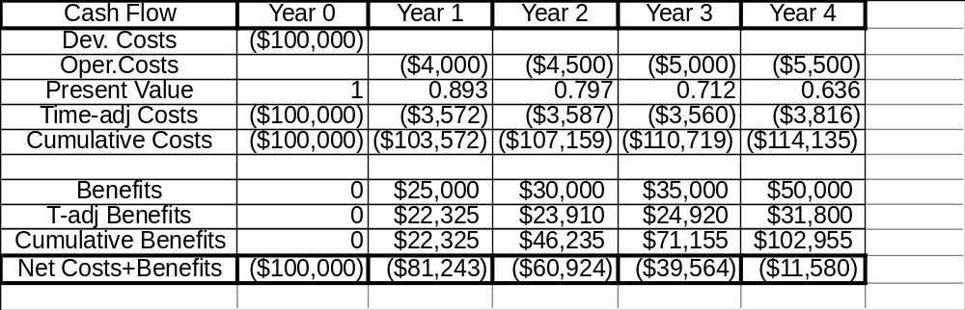
Net Present Value
Measures the total value of the investment
  …with all figures adjusted to present dollar values
    NPV = Cumulative PV of all benefits - Cumulative PV of all costs
  Assuming subsequent years are like year 4…
    the net present value of this investment in the project will be:
    after 5 years, $13,652
    after 6 years, $36,168
Notes:
Batch - 01
Mohamed Ishraque
HND in CSD - SAD - Feasibilty Studies

Slide 14
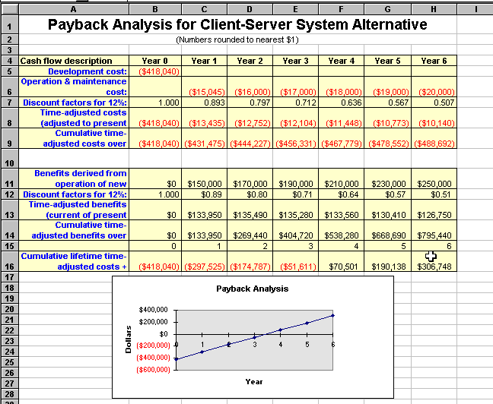
Notes:
Batch - 01
Mohamed Ishraque
HND in CSD - SAD - Feasibilty Studies

Slide 15
Computing the payback period
Can compute the break-even point:
  when does lifetime benefits overtake lifetime costs?
  Determine the fraction of a year when payback actually occurs:
  | beginningYear amount |
  endYear amount + | beginningYear amount |
  For our last example, 51,611 / (70,501 + 51,611) = 0.42
  Therefore, the payback period is approx 3.4 years
Notes:
Batch - 01
Mohamed Ishraque
HND in CSD - SAD - Feasibilty Studies

Slide 16
Return on Investment (ROI) analysis
For comparing overall profitability
  Which alternative is the best investment?
  ROI measures the ratio of the value of an investment to its cost.
ROI is calculated as follows:
  ROI = Estimated lifetime benefits - Estimated lifetime costs
  Estimated lifetime costs
  or:
  ROI = Net Present value / Estimated lifetime costs
  For our example
    ROI = (795,440 - 488,692) / 488,692 ≈ 63%,
    or ROI = 306,748 / 488,692 ≈ 63%
Solution with the highest ROI is the best alternative
  But need to know payback period too to get the full picture
    E.g. A lower ROI with earlier payback may be preferable in some circumstances
Notes:
Batch - 01
Mohamed Ishraque
HND in CSD - SAD - Feasibilty Studies

Slide 17
Schedule Feasibility
How long will it take to get the technical expertise?
  We may have the technology, but that doesn't mean we have the skills required to properly apply that technology.
    May need to hire new people
    Or re-train existing systems staff
    Whether hiring or training, it will impact the schedule.
Assess the schedule risk:
  Given our technical expertise, are the project deadlines reasonable?
  If there are specific deadlines, are they mandatory or desirable?
    If the deadlines are not mandatory, the analyst can propose several alternative schedules.
What are the real constraints on project deadlines?
  If the project overruns, what are the consequences?
    Deliver a properly functioning information system two months late…
    …or deliver an error-prone, useless information system on time?
  Missed schedules are bad, but inadequate systems are worse!
Notes:
Batch - 01
Mohamed Ishraque
HND in CSD - SAD - Feasibilty Studies

Slide 18
Operational Feasibility
How do end-users and managers feel about…
  …the problem you identified?
  …the alternative solutions you are exploring?
You must evaluate:
  Not just whether a system can work…
  … but also whether a system will work.
Any solution might meet with resistance:
  Does management support the project?
  How do the end users feel about their role in the new system?
  Which users or managers may resist (or not use) the system?
    People tend to resist change.
    Can this problem be overcome? If so, how?
  How will the working environment of the end users change?
  Can or will end users and management adapt to the change?
Notes:
Batch - 01
Mohamed Ishraque
HND in CSD - SAD - Feasibilty Studies

Slide 19
Feasibility Study Contents
Purpose & scope of the study
  Objectives (of the study)
  who commissioned it & who did it,
  sources of information,
  process used for the study,
  how long did it take,…
Description of present situation
  organizational setting, current system(s).
  Related factors and constraints.
Problems and requirements
  What’s wrong with the present situation?
  What changes are needed?
Objectives of the new system.
  Goals and relationships between them
Possible alternatives
  …including ‘do nothing’.
Criteria for comparison
  definition of the criteria
Analysis of alternatives
  description of each alternative
  evaluation with respect to criteria
  cost/benefit analysis and special implications.
Recommendations
  what is recommended and implications
  what to do next;
    E.g. may recommend an interim solution and a permanent solution
Appendices
  to include any supporting material.
Notes:
Batch - 01
Mohamed Ishraque
HND in CSD - SAD - Feasibilty Studies

Slide 20
Comparing Alternatives
How do we compare alternatives?
  When there are multiple selection criteria?
  When none of the alternatives is superior across the board?
Use a Feasibility Analysis Matrix!
  The columns correspond to the candidate solutions;
  The rows correspond to the feasibility criteria;
  The cells contain the feasibility assessment notes for each candidate;
  Each row can be assigned a rank or score for each criterion
    e.g., for operational feasibility, candidates can be ranked 1, 2, 3, etc.
  A final ranking or score is recorded in the last row.
Other evaluation criteria to include in the matrix
  quality of output
  ease of use
  vendor support
  cost of maintenance
  load on system
Notes:
Batch - 01
Mohamed Ishraque
HND in CSD - SAD - Feasibilty Studies

Slide 21
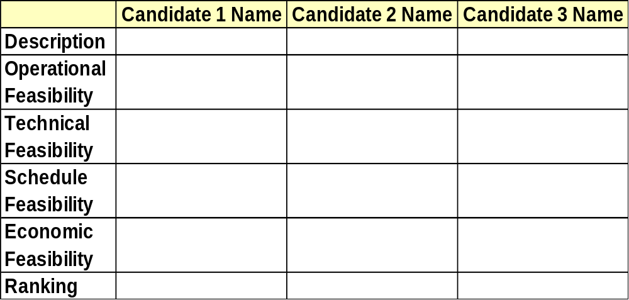
Example matrix
Notes:
Batch - 01
Mohamed Ishraque
HND in CSD - SAD - Feasibilty Studies

Slide 22
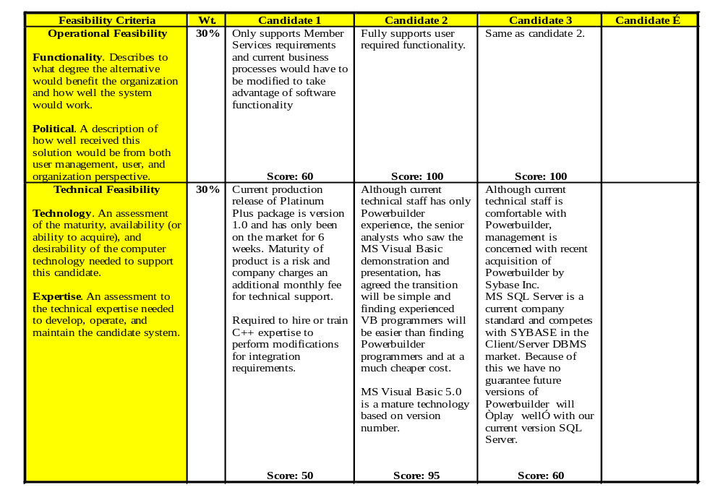
Notes:
Batch - 01
Mohamed Ishraque
HND in CSD - SAD - Feasibilty Studies

Slide 23
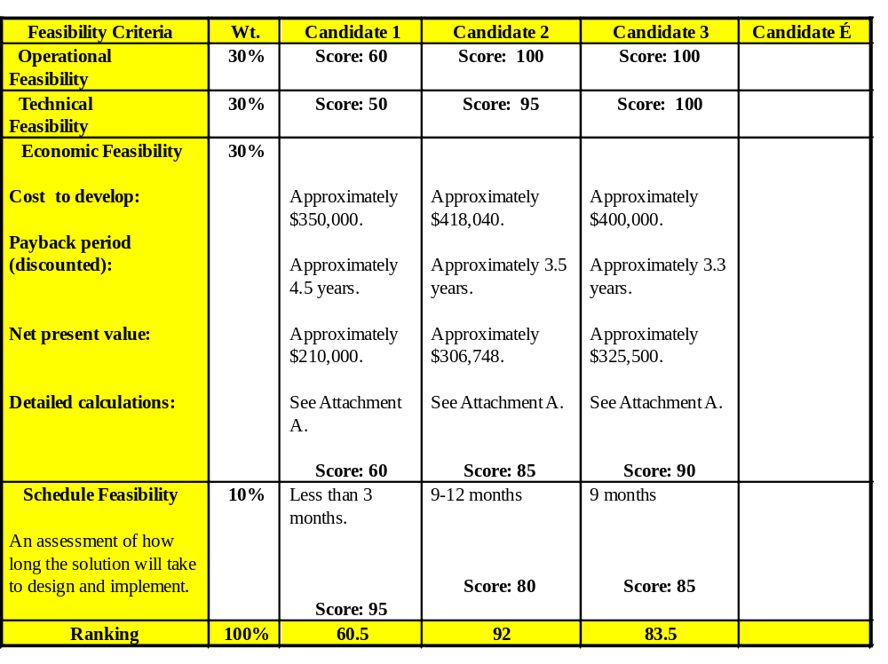
Notes:
Batch - 01
Mohamed Ishraque
HND in CSD - SAD - Feasibilty Studies

